Slide 1
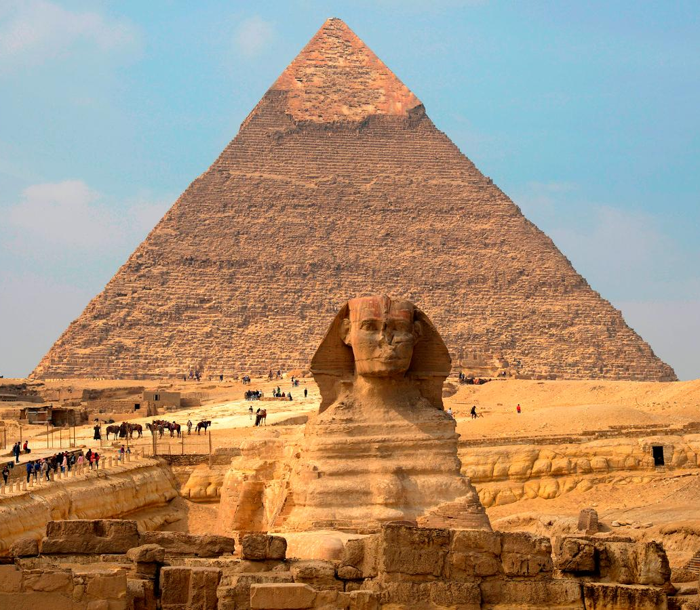
DOCO – Ancient Egypt
Get out book – no Title/goals
Week 7, Lesson 4

Slide 2
Doco Options -
Netflix – Unknown: The Lost Pyramid (tombs, archaeology, artefact hunts)
Youtube – Tomb Raiders: https://www.youtube.com/watch?v=l40aCcjslmg&ab_channel=NationalGeographic
Disney Plus – Lost Treasures of Egypt (tombs and artefact hunts)
Disney Plus – Kingdom of the Mummies (archaeology)

